Slide 1
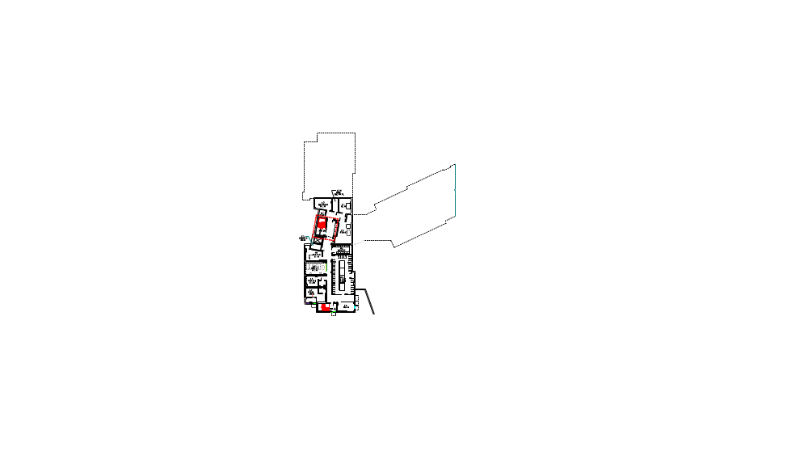

East Hall – Lower Level Floor
Emergency Evacuation Plan
In the event of an emergency evacuation alarm
-
1. Immediately exit the facility via exit stairwells - DO NOT USE ELEVATORS!
2. Proceed to the Rally/Assembly area. (Campus Center, Ground Floor, Grand Staircase)
Note:
1. Don’t re-enter the building until directed to do so by authorized personnel.
2. If smoke is present, crawl and keep as close to the floor as possible.
3. Never panic by running. If clothes catch fire, immediately STOP, DROP and ROLL.
Legend
Symbol Description
L00
Room Number
Room Locator (“You are here”)

